Slide 1
Microsoft 365 & Power Platform Development – Bi-weekly call
Your host in this call: Vesa Juvonen (Microsoft)
September 29th, 2022

Slide 2




v
Agenda
Latest Updates on community
PnP .NET libraries
PnP PowerShell
Latest on yo Teams
Latest on Microsoft Graph Toolkit
Independent Publisher Connectors
Latest on script samples
Latest Microsoft Teams samples
Latest on Power Platform samples
Picture time with the Together Mode!
Lee Ford and Luise Freese - How to build a good vibes generator for Teams
Markus Möller - Movie vote Teams app

Slide 3
Opportunities to Participate in the community
Demo solution or technical pattern
Contribute on GitHub
Provide feedback
Great opportunity to get visibility for you or your company. Demo sample or explain how you extend or customize SharePoint Online with live demo in your projects. Reach out to team for volunteering.
Request a demo spot on the call
https://aka.ms/m365pnp/request/demo

Slide 4
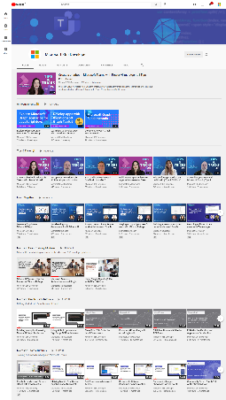
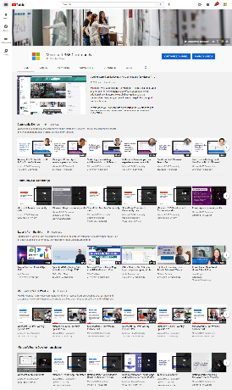
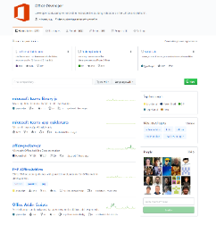
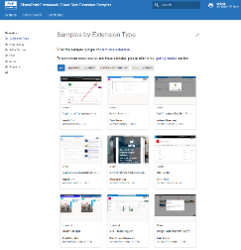
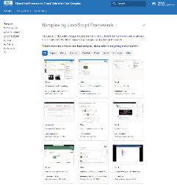
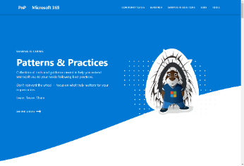
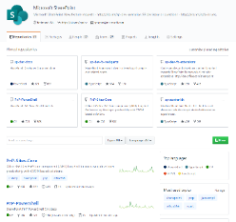
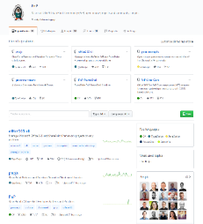
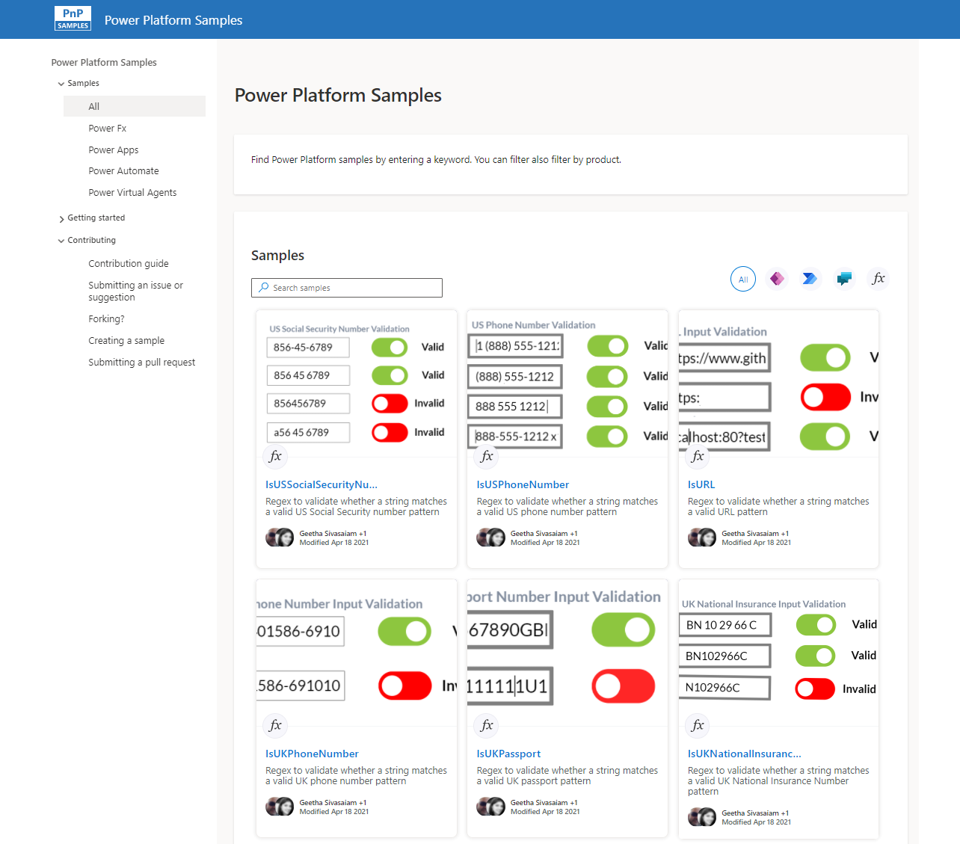
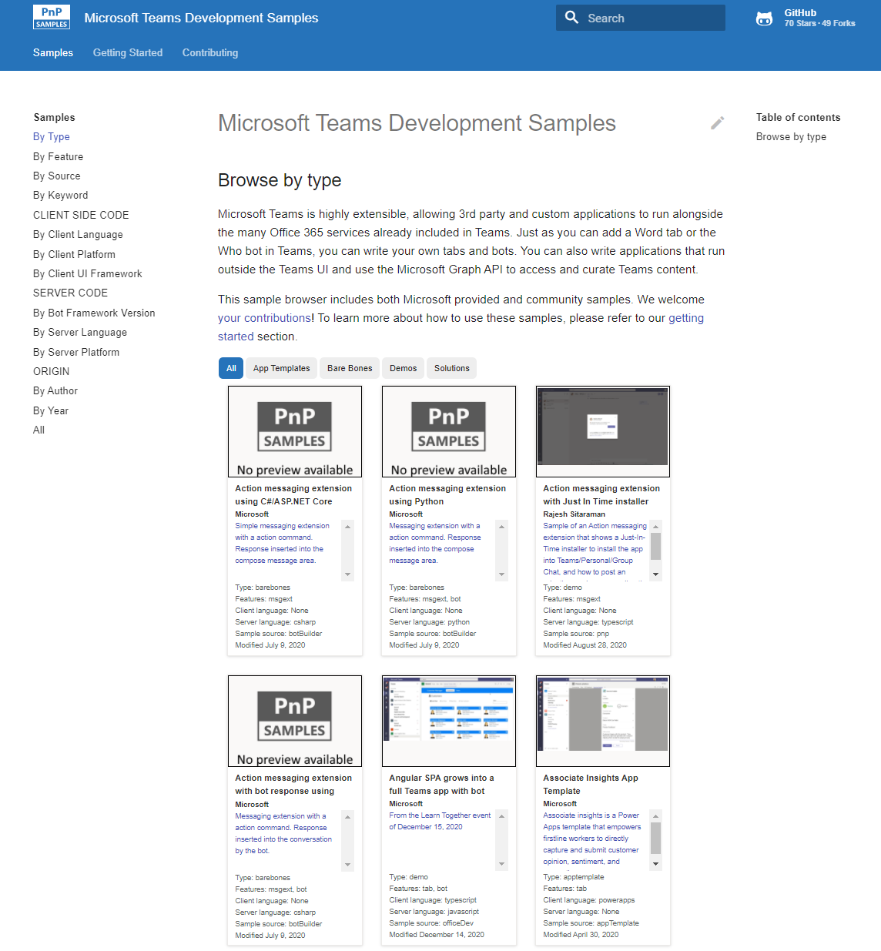
Microsoft 365 developer videos
Microsoft 365 community videos
Open-source
Sample galleries
Open-source initiatives and samples
github.com/sharepoint
github.com/pnp
github.com/officedev
github.com/microsoftgraph
aka.ms/m365/samples
aka.ms/teams-samples
aka.ms/spfx-webparts
aka.ms/powerplatform-samples
aka.ms/spfx-extensions
aka.ms/list-formatting
aka.ms/m365/community
aka.ms/m365devyoutube
aka.ms/m365pnp/videos
@Microsoft365Dev | @m365pnp

Slide 5
Microsoft 365 developer community calls
Microsoft 365 platform (weekly) https://aka.ms/m365-dev-call
Adaptive Cards https://aka.ms/adaptivecardscommunitycall
Microsoft identity platform https://aka.ms/IDDevCommunityCalendar
Office Add-ins https://aka.ms/officeaddinscommunitycall
Power Platform https://aka.ms/PowerPlatformMonthlyCall
Microsoft 365 & Power Platform Development (bi-weekly) https://aka.ms/m365-dev-sig
Viva Connections & SharePoint Framework (bi-weekly) https://aka.ms/spdev-spfx-call
Download recurrent invites from
https://aka.ms/m365/calls
Notes:
m365-dev-sig

Slide 6



Latest news from Microsoft engineering on the Microsoft 365 topics
Community together mode group photo
Brian T. Jackett and Cameron Parker – Introduction to Privacy APIs on Microsoft Graph
Garry Trinder – Build your first Notification bot for Microsoft Teams with Teams Toolkit for Visual Studio Code
Bob German and Aditya Challapally - Account Linking for Teams apps
Microsoft 365 platform call
4th of October @8 AM PT
https://aka.ms/m365-dev-call

Slide 7
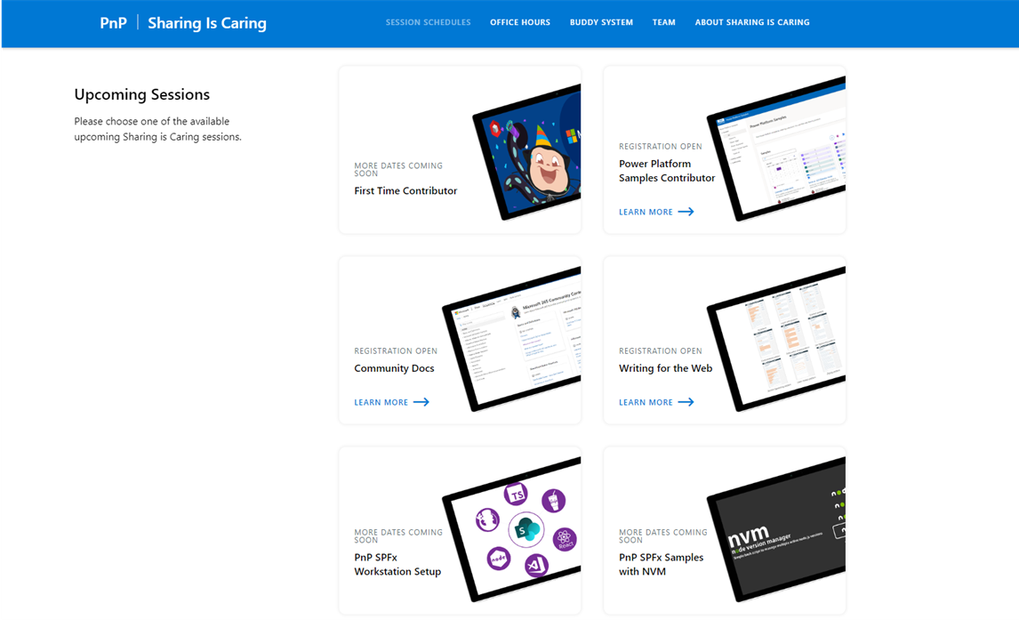
GUIDANCE
Learn how to get started in the open-source PnP community!
Upcoming Sessions:
First-time contributor
Power Platform Samples Contributor
Writing for the Web
Community Content Docs
SPFx Developer Workstation Setup
Using PnP SPFx samples w/ NVM
More than code with VS Code
First-time presenter
M365 Maturity Model Practitioners
Power Platform Samples Contributor
https://aka.ms/sharing-is-caring
New Dates Coming Soon
Notes:
25 Total attendees, 16 attendees who attended both First-Time Contributors and Community Docs sessions.

Slide 8





COMMUNITY
PnP Recognition Program
Showcasing your contributions
Powered by Credly
More achievement levels coming soon
https://aka.ms/m365pnp-recognition
Notes:
25 Total attendees, 16 attendees who attended both First-Time Contributors and Community Docs sessions.

Slide 9
Project specific updates Updates and progress on the different open-source tooling lead by Microsoft and community members. You are welcome to join the projects – your feedback matters! 🚀🧡

Slide 10
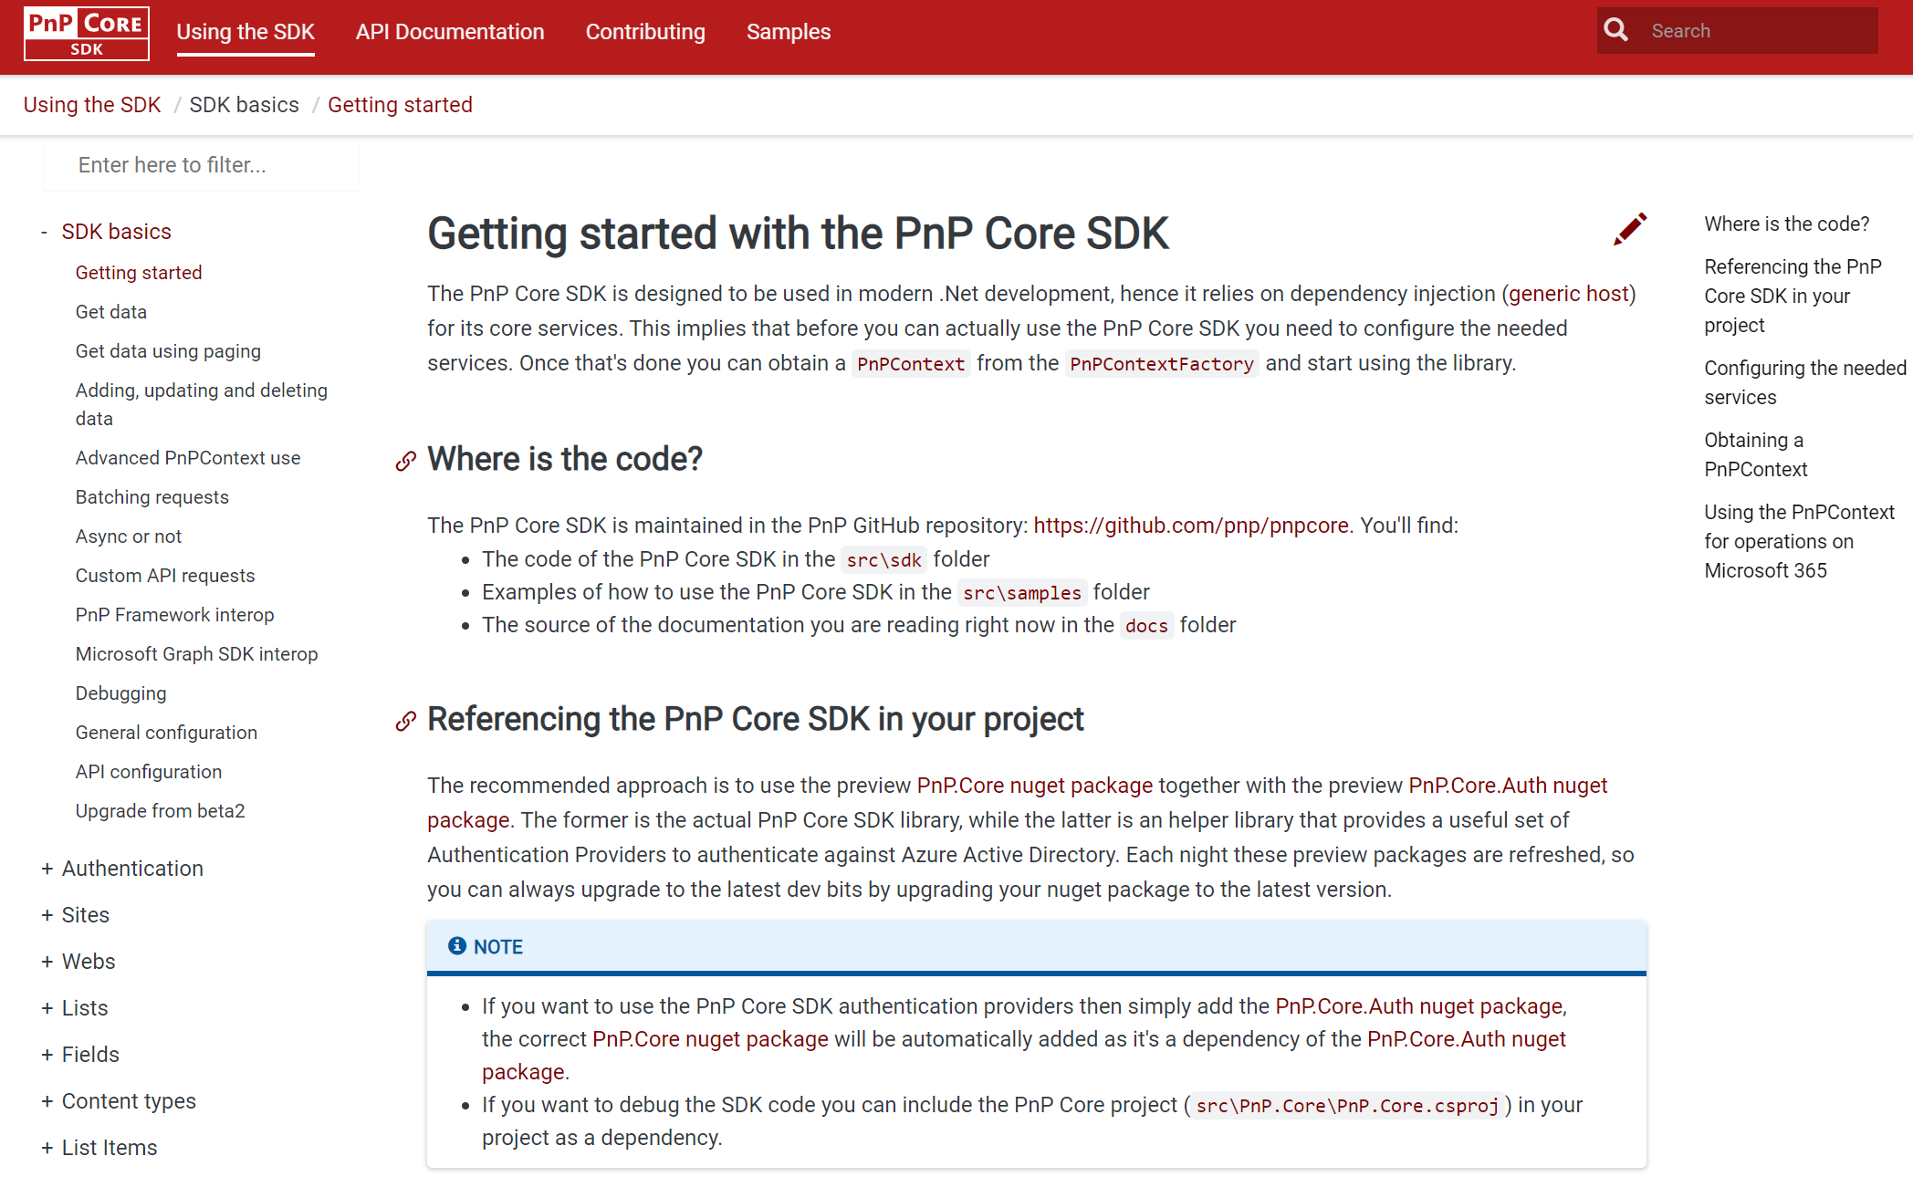
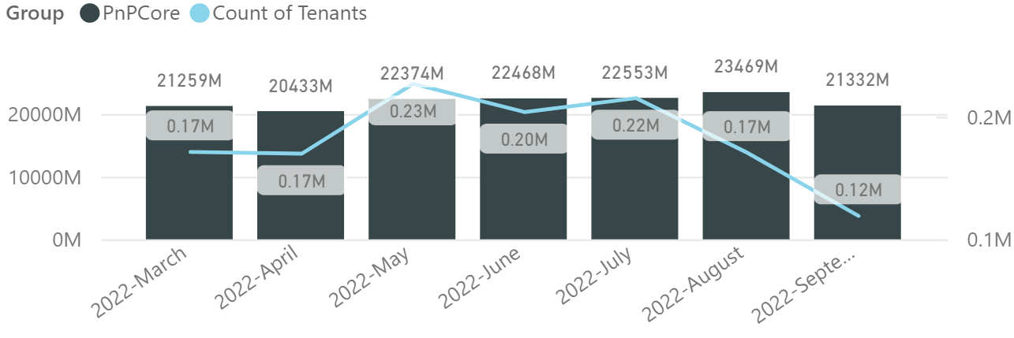
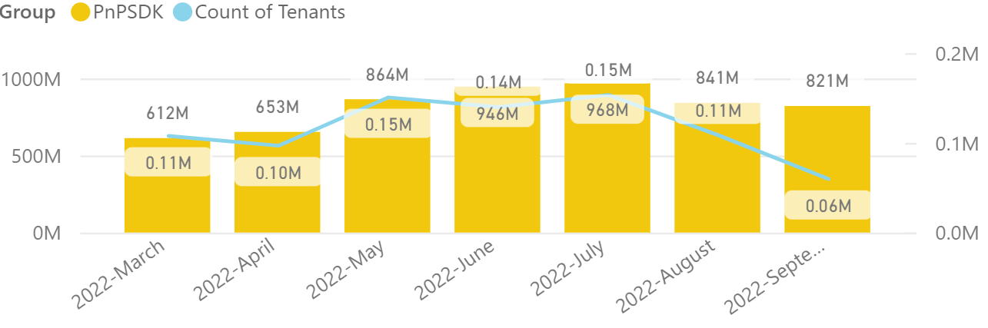

PnP .NET libraries
PnP Framework
PnP Core SDK
>170.000
Tenants in a month!
>765,000 downloads!
Prepping 1.11.0:
Merge pending PRs
New PnP Provisioning Schema v. 202209 is upcoming:
Feedback welcome on GitHub repo (https://github.com/pnp/PnP-Provisioning-Schema)
>990,000 downloads!
Prepping for 1.8.0:
RateLimit support, support for deleting recycled site collections: Bert Jansen 🚀
ResourceBehaviorOptions setting during group provisioning (merging today): Koen Zomers 👍
Working on it
What key scenarios are still missing?
https://github.com/pnp/pnpcore/blob/dev/src/sdk/CHANGELOG.md
Roadmap
nuget.org/profiles/pnp
nuget.org/profiles/pnp
aka.ms/pnp/framework
aka.ms/pnp/coresdk

Slide 11
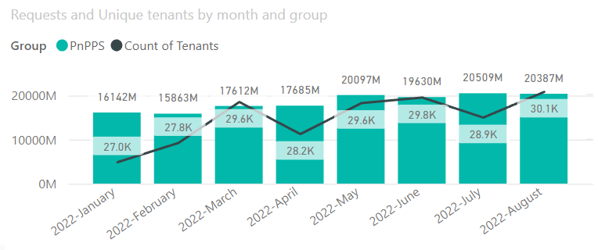

PnP PowerShell
Cross Platform PnP PowerShell
>30.000 tenants in a month!
V1.11.0 released Many updates, improvements and fixes!
3 million downloads!
100 million cmdlets executed per day!!
Docs shifted, no more docs.microsoft.com
Documentation, Articles and tips available at : https://pnp.github.io/powershell
Thinking of dropping support for PS 5, any strong objections ???
PnP PS runs in PS 5, PS 7, Azure CloudShell, Azure Functions, Azure Runbooks & Raspberry Pi
New Stuff
Nightly builds continue
Added Get-PnPAzureADActivityReportDirectoryAudit cmdlet to retreive audit logs
Working on Managed identity support for SharePoint related cmdlets, already supported for Graph cmdlets
Bug fixes and improvements continue
What next, .NET 6.0 support ? Would love to hear your thoughts !
Release: https://github.com/pnp/powershell/releases/tag/v1.11.0
PnP PowerShell extension - Visual Studio Marketplace
Working on it
github.com/pnp/powershell
www.powershellgallery.com
PnP.PowerShell
https://github.com/pnp/powershell/blob/dev/CHANGELOG.md

Slide 12
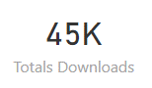
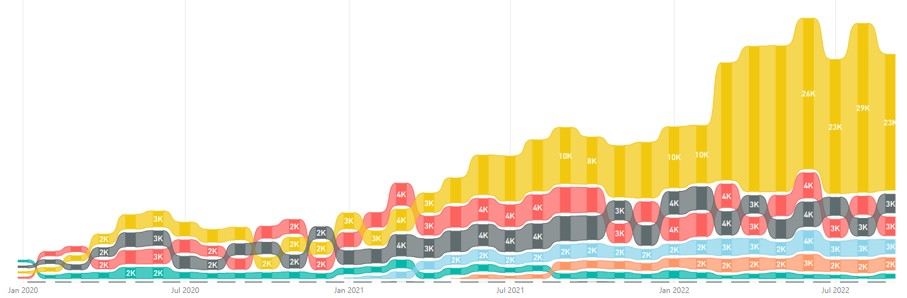
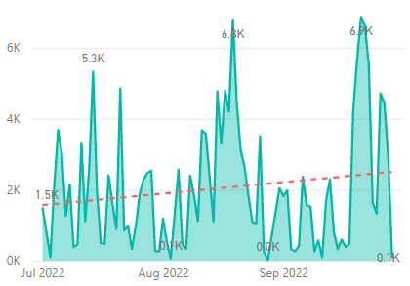
yo teams
https://aka.ms/yoteams
generator-teams – The Teams apps generator
📃 Docs published at https://pnp.github.io/generator-teams/
🚀 Latest release: 4.0.1 [2022-06-28]
Fixed an issue with tab configuration
📅 Top of mind:
⁉️ VS Code extension for yo teams ⁉️
Option to add SSO for Teams apps during scaffolding
Option to integrate Microsoft Graph Toolkit
Update UX of scaffolded tabs
Add support for meeting extensions
More Docs & Tutorials
Package Downloads
yoteams-build-core
yoteams-deploy
Daily build events
🚀 Latest release: 1.7.0 [2022-06-23]
Added support for Schema 1.13. Requires Node 14 or later Dependency package updates Fixed issue with telemetry timeout at the end of scaffolding
🔮 Preview: n/a 📅 Roadmap: ???
🚀 Latest release: 1.2.0 [2022-06-23]
Requires Node 14 or later Dependency package updates
🔮 Preview: : n/a
📅 Roadmap:
???

Slide 13

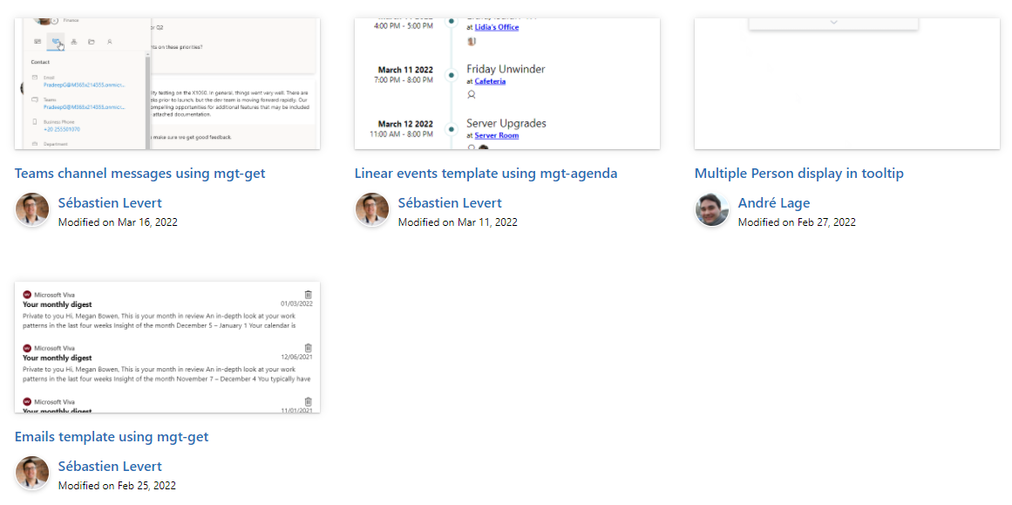

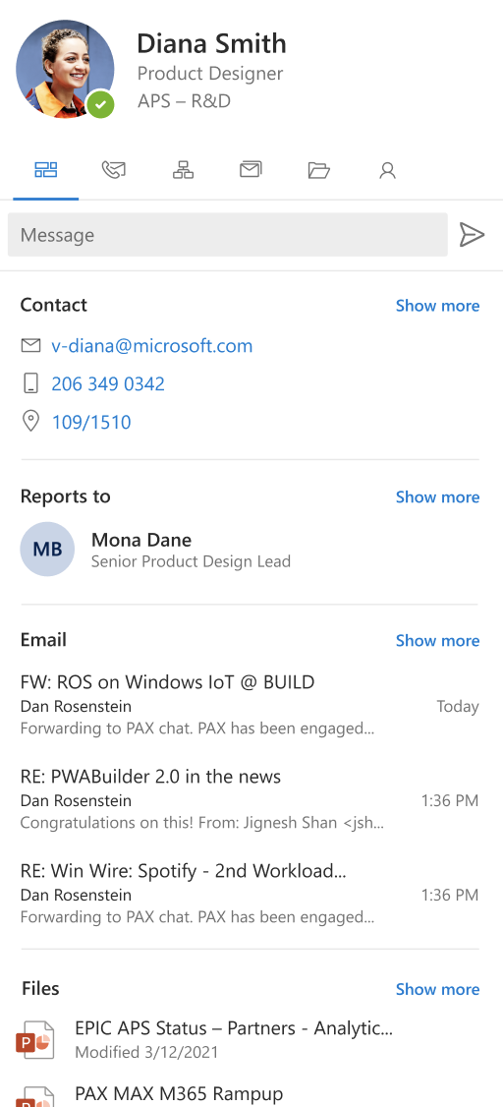
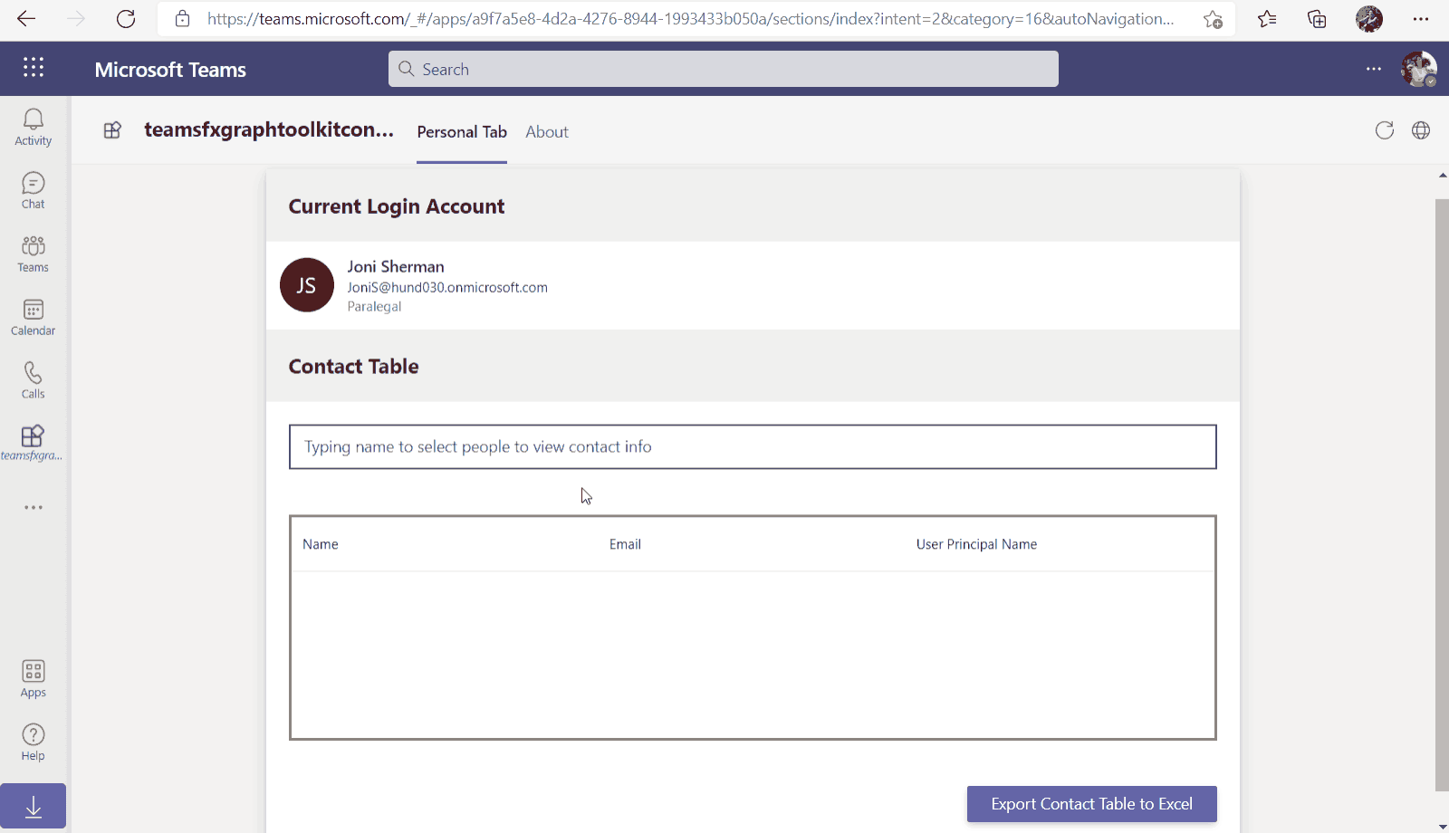
Microsoft Graph Toolkit
👀 More information: aka.ms/mgt
What’s new 🎉
V2.6.1 is our latest release! Update your packages! https://aka.ms/mgt/v2.6.1
Fixes to the mgt-people-picker and mgt-person-card
Renamed SPFx package
New tutorial : Build productivity apps by using Microsoft Graph Toolkit | Microsoft Learn
Thanks @HiltonGiesenow, @AndersSahlin and @aycabas for your contributions 🎉
The MGT samples repository is live! Keep your contributions coming! https://aka.ms/mgt/samples
What's next? 💻
Aligning all Toolkit components to Fluent UI Web Components
More generic components and theming capabilities
Install our v3.0 preview!
npm i @microsoft/mgt@next.fluentui
We need your help ❤️
🐞 Help us fix bugs
🆕 Help us build/improve features
help-wanted & good-first-issue -> https://aka.ms/mgt/issues

Slide 14

Independent Publisher Connectors
What’s new
60 Awesome Independent Publishers!
Priyanshu Srivastav
Kevin Comba
Bernard Karaba
John Muchiri
Vitalii Sorokin
173 Independent Publisher connectors!
2 IP Connector Updates!
Badgr – Troy Taylor
GitLab – Roy Paar
New connectors: 4
Miyake Hideo - Connpass
FlowJoe (Joe Unwin) - Fantasy Premier League
Troy Taylor - You Need A Budget
Kiveshan – Proposal for Open Trivia DB
We need your help
Become an Independent Publisher by building one of these connectors: Top Connector Asks · microsoft/PowerPlatformConnectors Wiki (github.com)
OR
By adding more functionality to one of the existing Independent Publisher connectors on the Power Platform
Notes:
Jocelyn Panchal <jopanchal@microsoft.com>

Slide 15
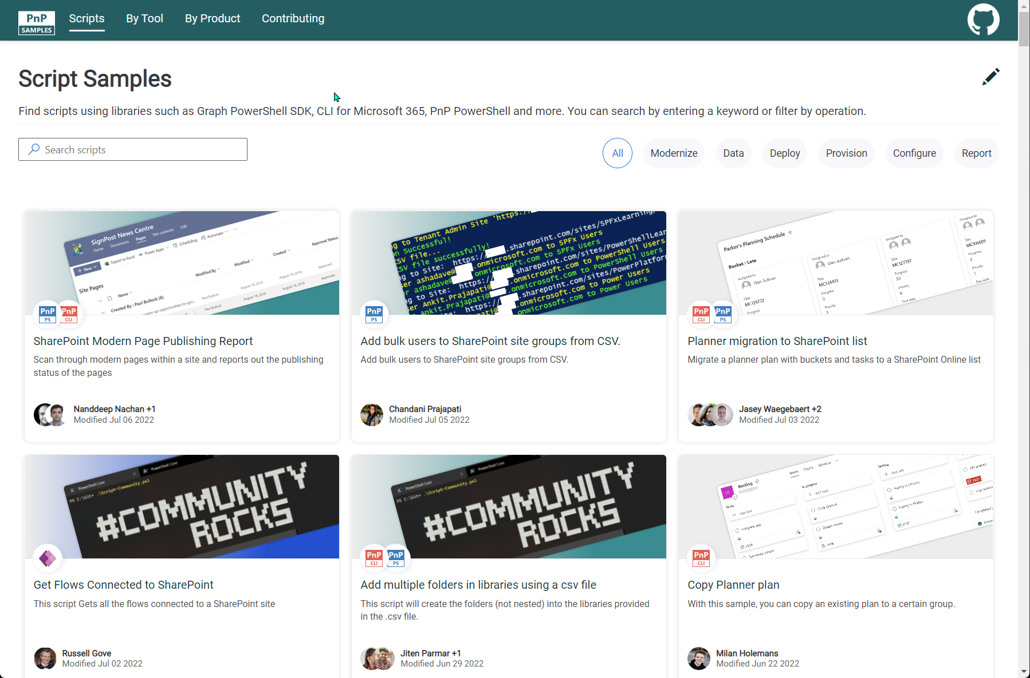


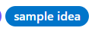
SCRIPT SAMPLES
One centralized location for all scripts for helping your day-to-day life. Contribution's welcome!
Site now has 171 scenarios and 256 scripts, using Microsoft Graph, CLI for Microsoft 365, PnP PowerShell, SPO Management Shell tooling and more…😁 AND samples integrated into "Unified" Solution Gallery
Awesome 🤩😃🎉👏 Samples Include :
New Scenario using PnP PowerShell
Get all files in a Document Library along with Created By and Modified By - Todd Klindt
Create a Quick Links web part with items defined in a datasource by Kasper Larsen
Add Content Type Hub with calendar format field to List by André Lage
New scenario using Graph PowerShell SDK
Get users by license and review last signed in by Paul Bullock
Did you know you can filter by cmdlet? Just type it in the search and see the results.
Want to contribute:
We have contribution guidance to get going using the “contributing” link on the site navigation or reach out to Paul Bullock on Twitter (@pkbullock), open to DMs, if you need help to get going.
We are labeled for Hacktoberfest! 4 Pull Requests and no Spam (spaces etc) ones
Thank you for your samples and contributions – your awesome and happy autumn!
Ramin Ahmadi
Martin Lingstuyl
Reshmee Auckloo
Todd Klindt
Leon Armston
Paul Matthews
Lewis Baybutt
Ramin Ahmadi
Arash Aghajani
Michaël Maillot
Nik Charlebois
Jason Baxter
Kasper Larsen
André Lage
👏
aka.ms/script-samples
good first issue
We have good firsin the GitHub Repo with sample ideas of scripts that you could contribute to ☺ https://github.com/pnp/script-samples
Notes:
Paul

Slide 16

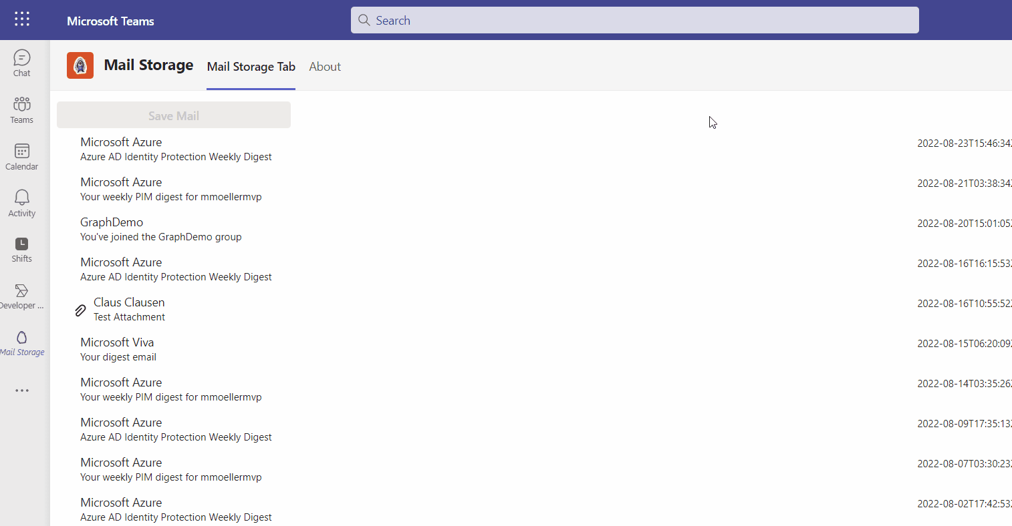







Microsoft Teams Samples
Now available!
Volunteers Needed!
New sample from the amazing Markus Möller!
Works in Teams and Outlook
Store emails in OneDrive
https://aka.ms/tab-office-sso-mail-save
Check out all the samples! https://aka.ms/m365/samples
Teams samples w/filtering https://aka.ms/teams-samples
SAMPLES WANTED!
SAMPLES WANTED!
Please check out all the samples! https://aka.ms/m365-samples
https://aka.ms/teams-samples
Notes:
Wajeed Shaikh – Teams PM

Slide 17

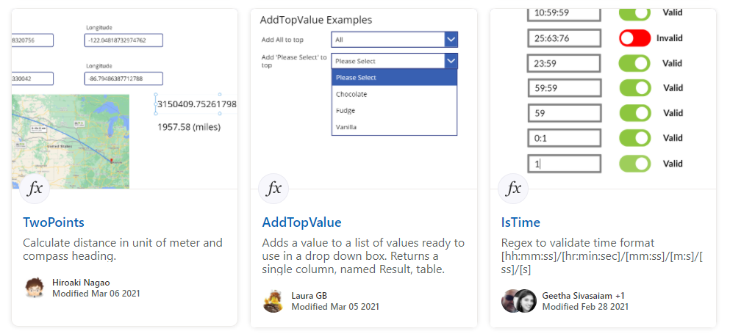
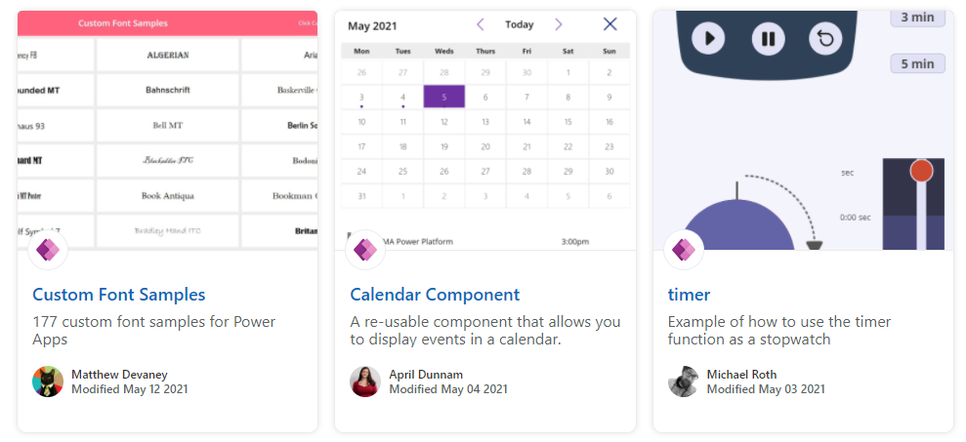
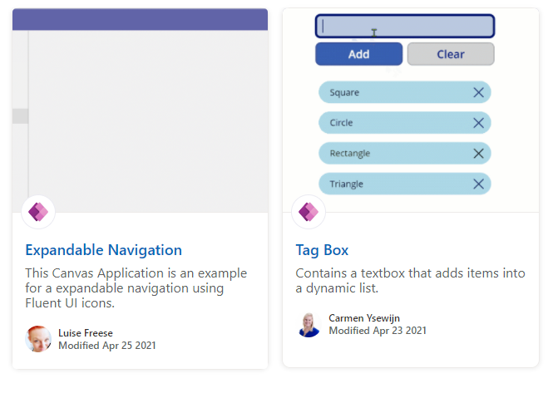
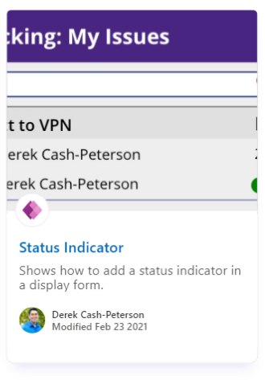
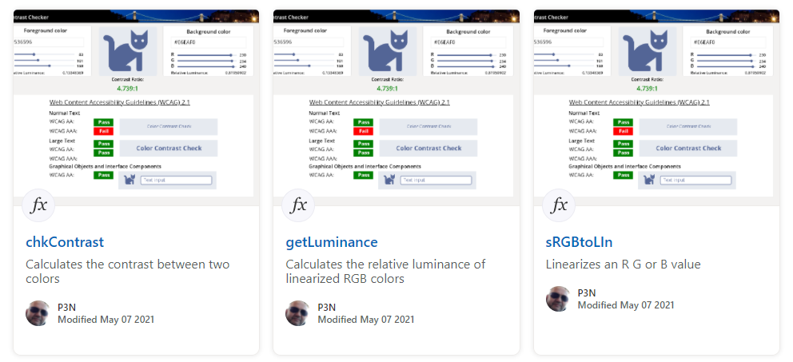
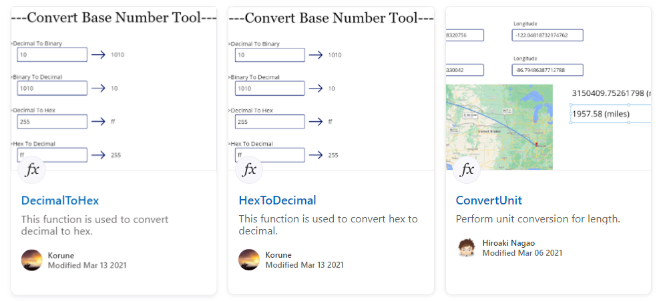
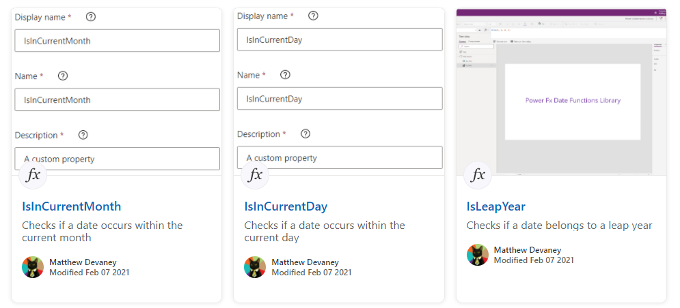
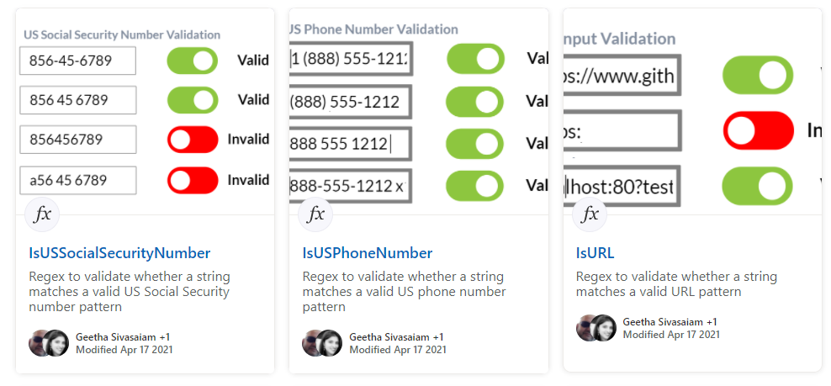
Power Platform Samples
aka.ms/powerplatform-samples ​
Power Apps templates​
Power Apps components​
Power Apps connectors​
Power Fx Custom Functions
Power Automate flow templates​​
PowerBI​​
Power Virtual Agents​​
Power Platform Contributors
Sharing is Caring Session
New Dates Coming Soon!!!

Slide 18
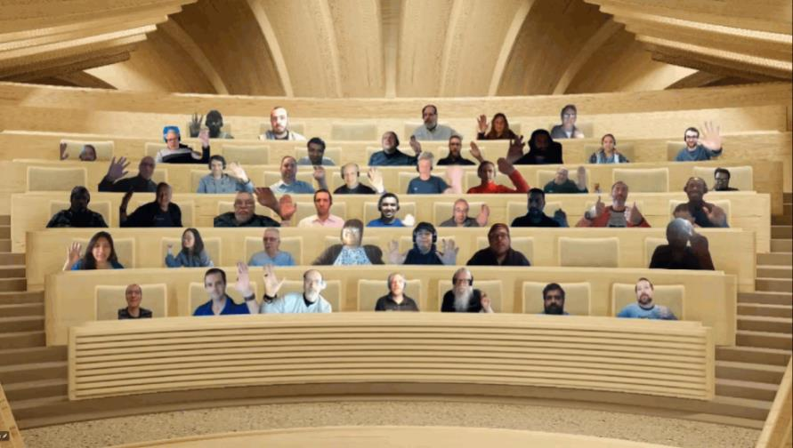

Optional picture time!
Video on and we’ll grab a Together Mode pic with those who are willing to do this.
We are together on this as a community!
By enabling your camera for the picture, you’ll give us the permission to share your picture in social media.

Slide 19
DEMO
How to build a good vibes generator for Teams – Lee Ford
– Luise Freese
Movie vote Teams app – Markus Möller

Slide 20

Q&A

Slide 21
Thank you
Recording will be available in 24 hours on
Microsoft 365 Community (PnP) YouTube channel
https://aka.ms/m365/videos
(subscribe today)
Follow us on Twitter
@Microsoft365Dev | @M365PnP
Next M365 General Dev call: October 13th at 07:00am PT
Next Viva Connections & SharePoint Framework call: October 6th at 07:00am PT
See all other community calls from https://aka.ms/m365/calls

Slide 22



Slide 23
Thank you

